Slide 1
Two-edged SOROBAN
Presented By :-
Shruti Bindal (191500791)
Vasundhara Tiwari (191500902)
Yashasvi Gupta (191500936)
Yashika Gupta (191500939)

Slide 2
Outline
About the Project
Objective
Requirements
Snapshots of the website

Slide 3
About the Project
“Two-Edged Soroban” as the name suggests is a type of abacus which means calculations and games . Hence, our website provides several options to work with :-
• Scientific Calculator:- To perform certain mathematical functions and various calculations.
• Currency Convertor:- A tool, that allows for the quick conversion of any currency into any other currency.
• 2048 :- A game , which sharpens your mind.
• Tic-Tac-Toe:- A simple game , which is liked and played by all age group.
• Stopwatch:- A kind of watch that stands out for the accuracy and precision.

Slide 4
Objective
The objective of our project is :-
Calculations:- It has two types of tools i.e, Scientific Calculator and Currency Convertor for calculations.
Entertainment and Creativity:- For this purpose , we have 2048 and tic-tac-toe games. This enhances our imaginative play and problem solving skills.
User-Oriented:- The project is designed in such a way that it is user-friendly and can be easily understood with even untrained users

Slide 5
Requirements
Software requirements
Windows/Linux Operating System
Visual Studio Code
Programming Languages
Javascript
HTML
CSS

Slide 6
Requirements
Hardware requirements
Computer System with minimum 8GB of RAM
Web Browsers – Google Chrome, Microsoft Edge or any other web browser
Note -: older browsers may not support some features of the HTML5 and CSS3

Slide 7
The look of the website :-

Slide 8
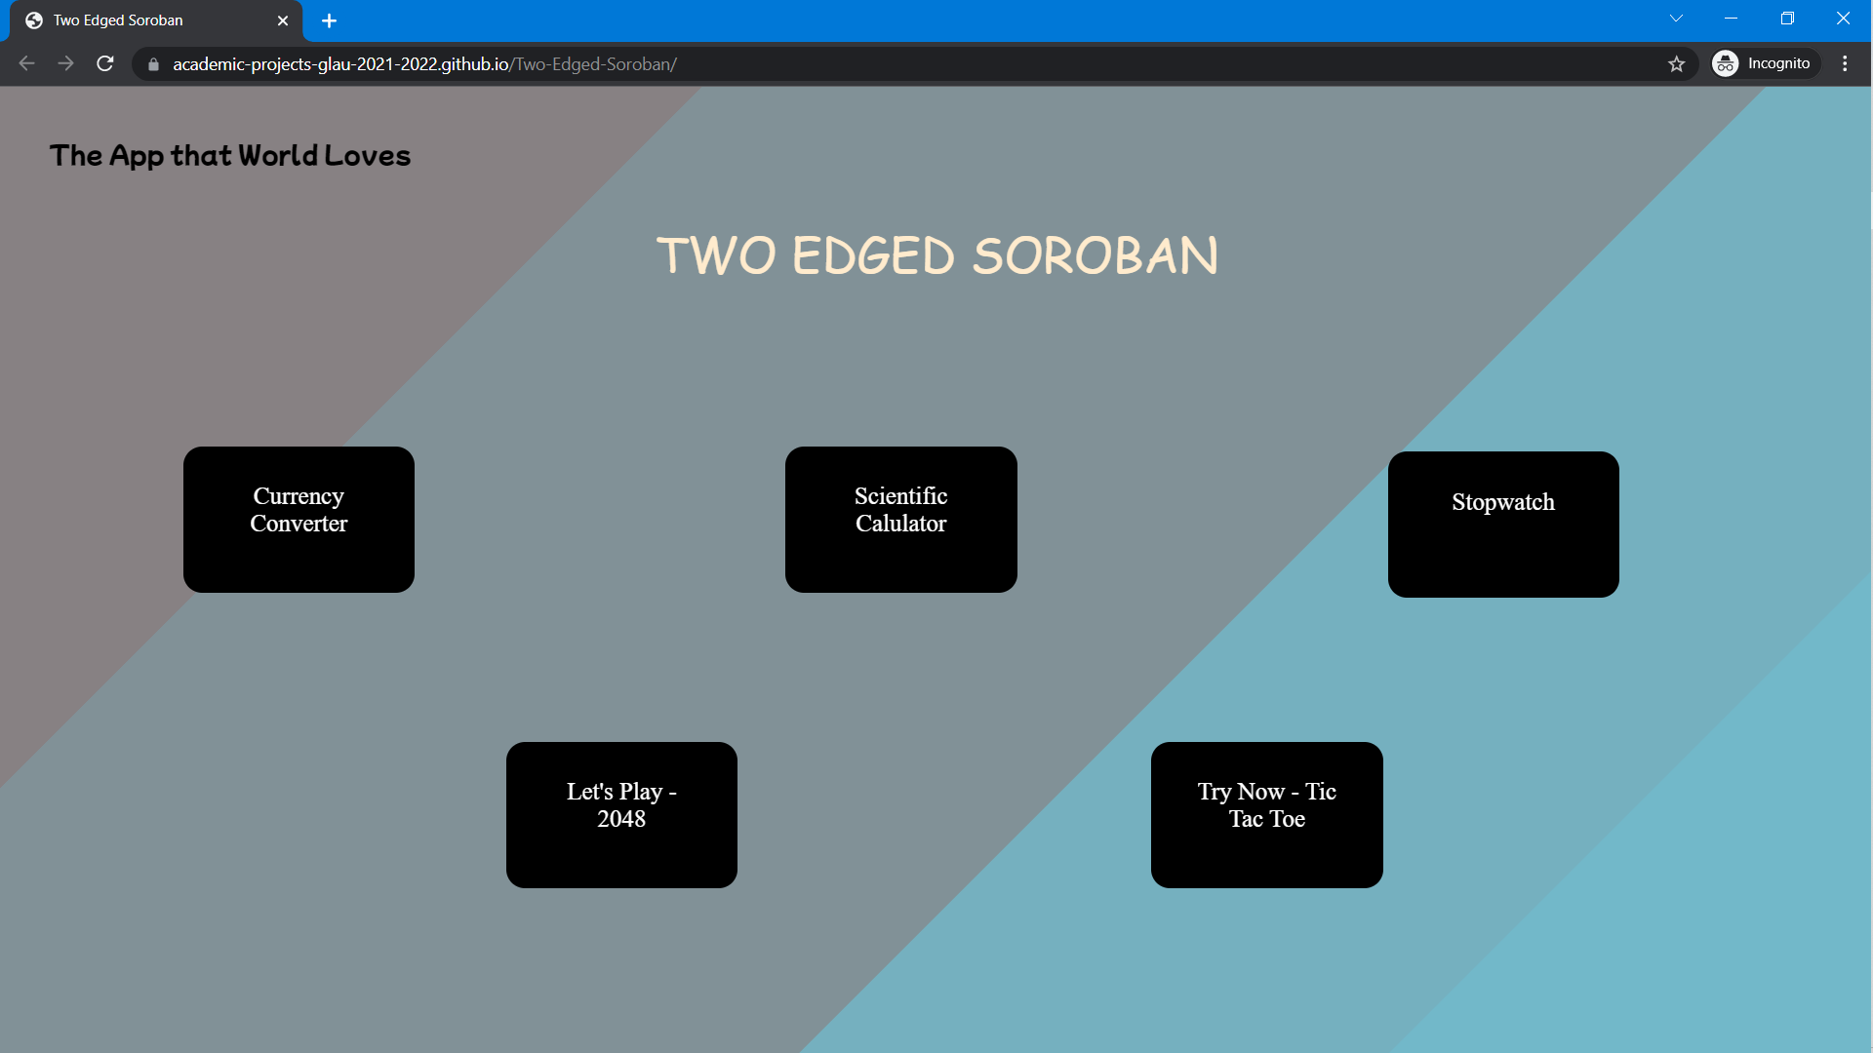
Landing Page

Slide 9
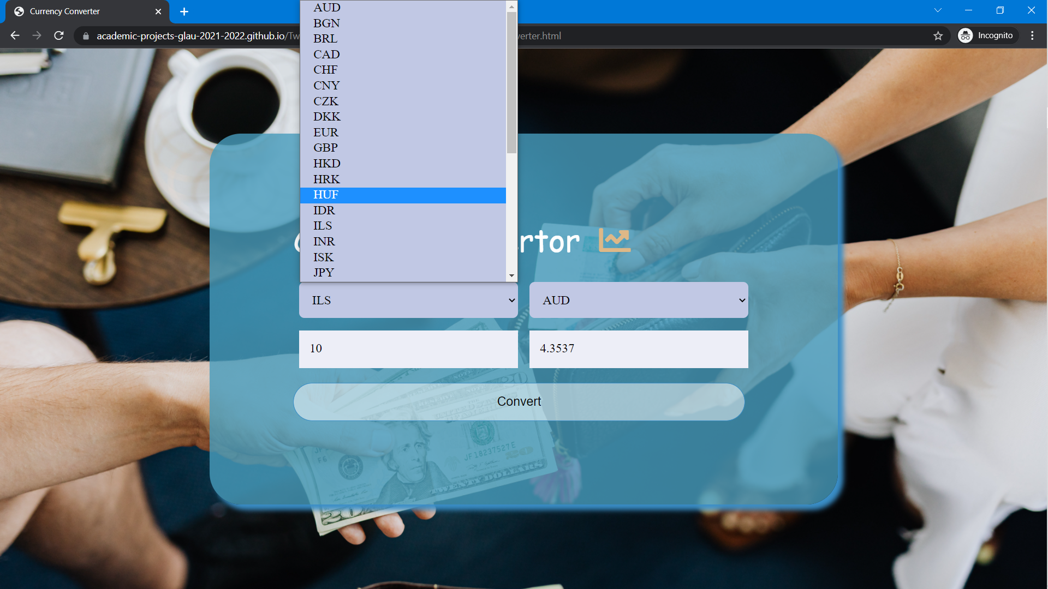
2. Currency Converter

Slide 10
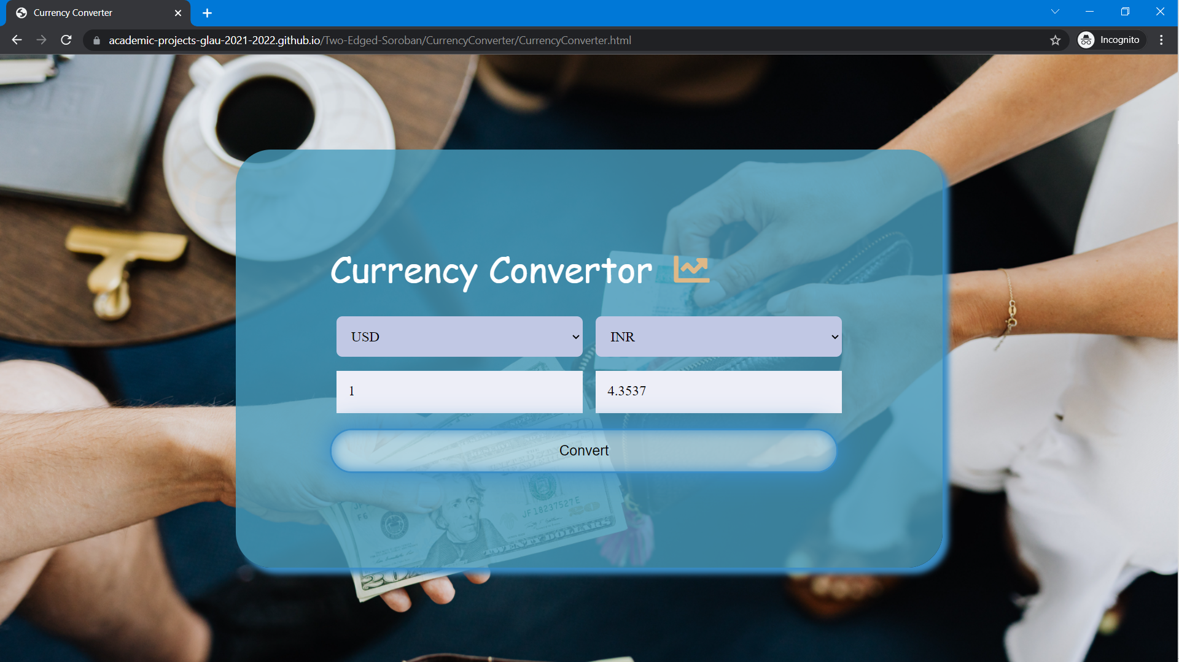
2. Currency Converter

Slide 11
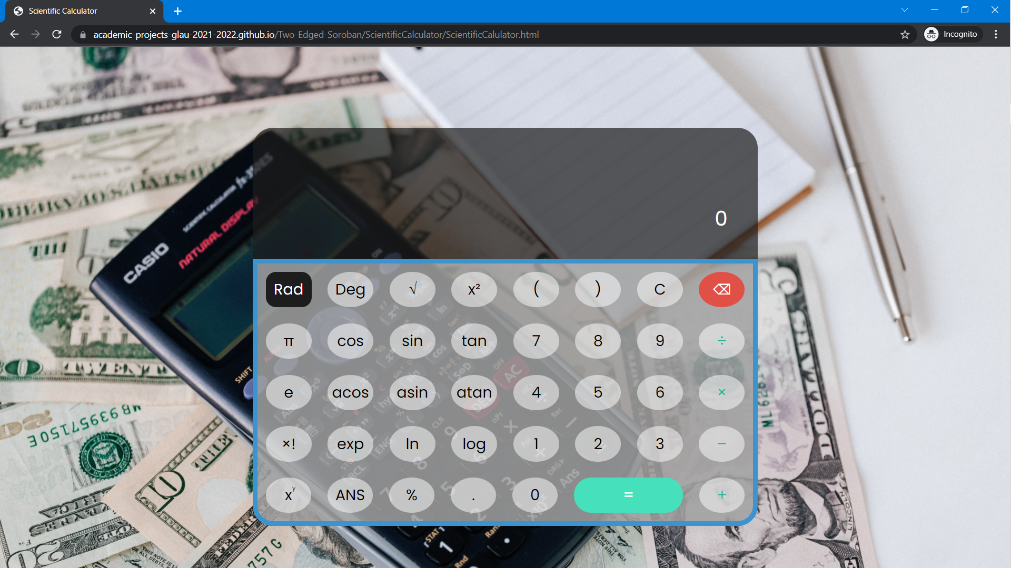
3. Scientific Calculator

Slide 12

4. Scientific Calculator

Slide 13
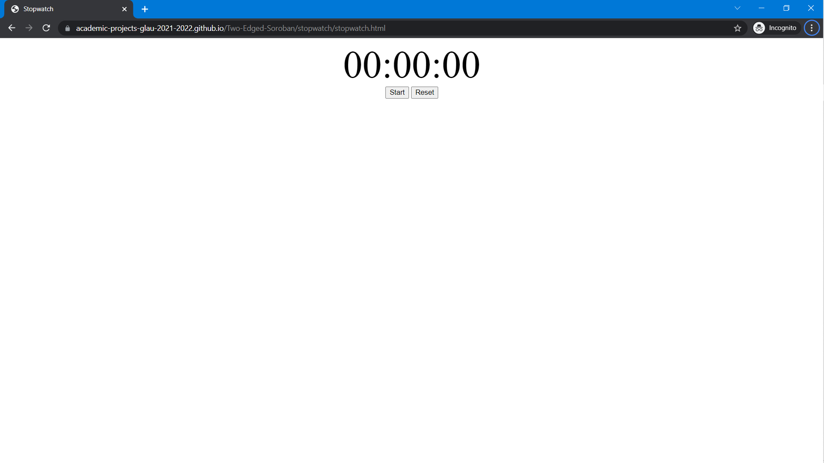
5. Stopwatch

Slide 14
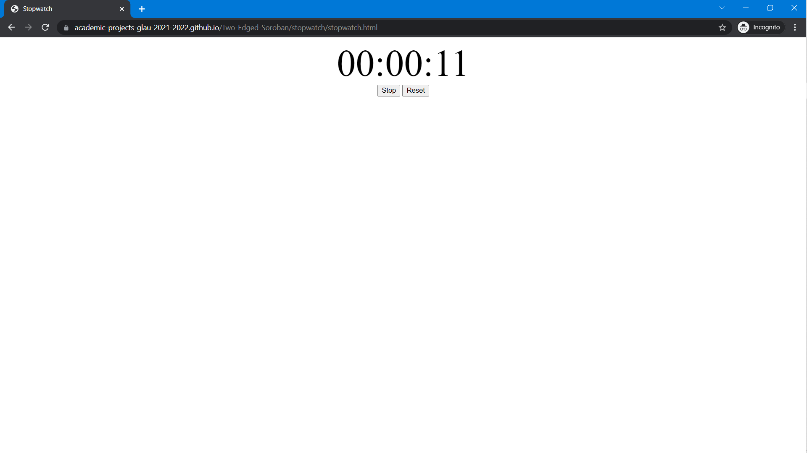
6. Stopwatch

Slide 15
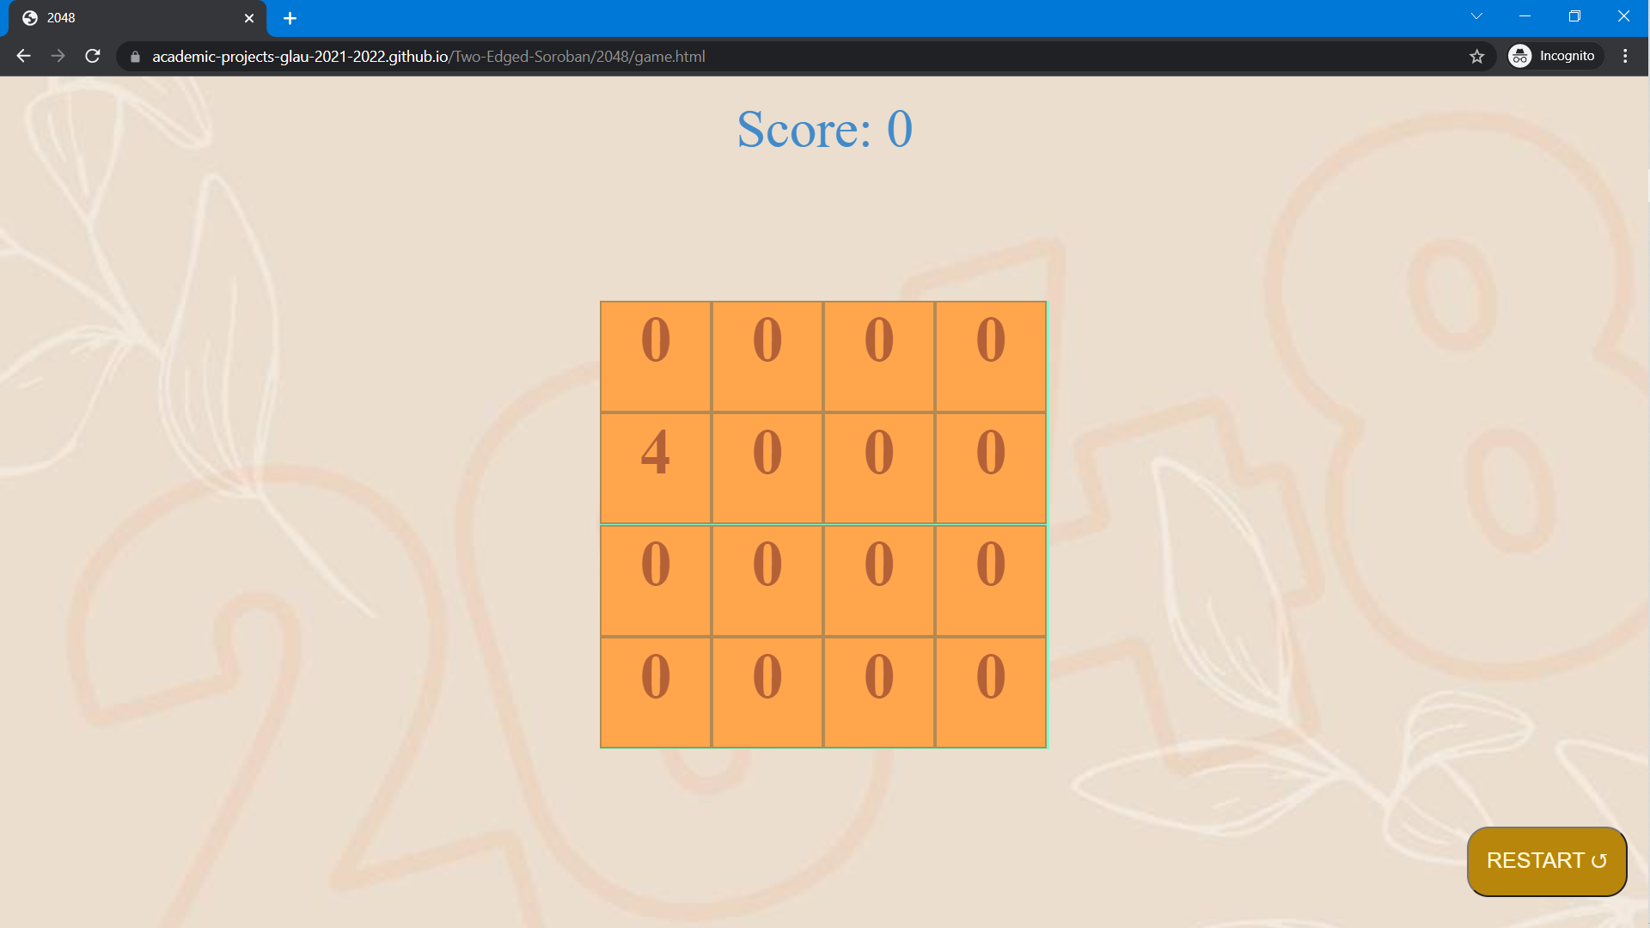
7. Play : 2048

Slide 16

8. Play : 2048

Slide 17
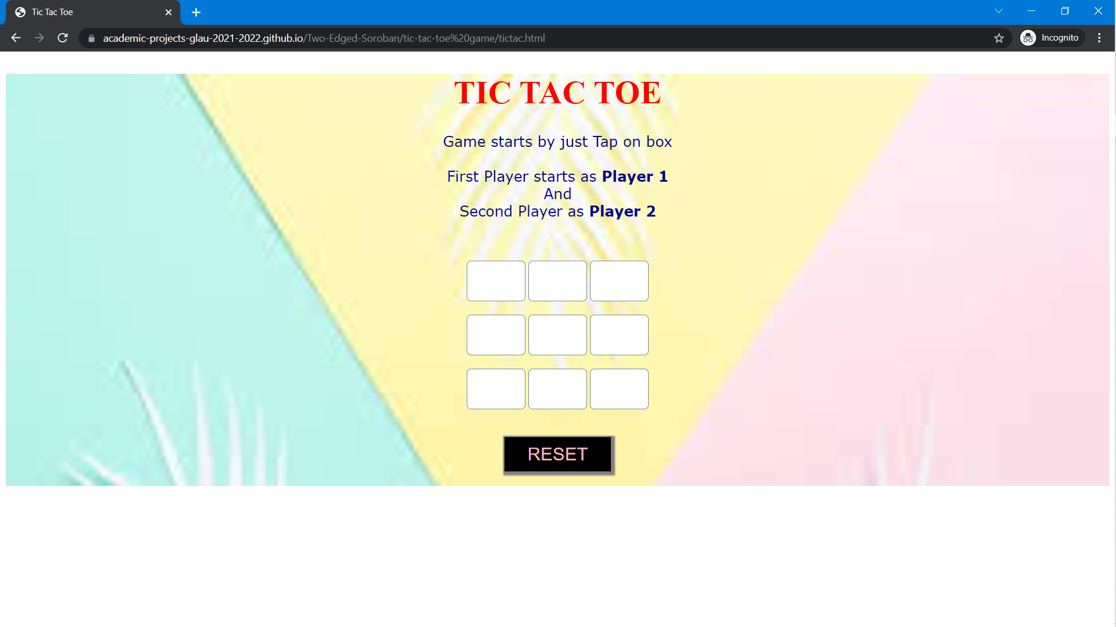
9. Tic – Tac - Toe

Slide 18
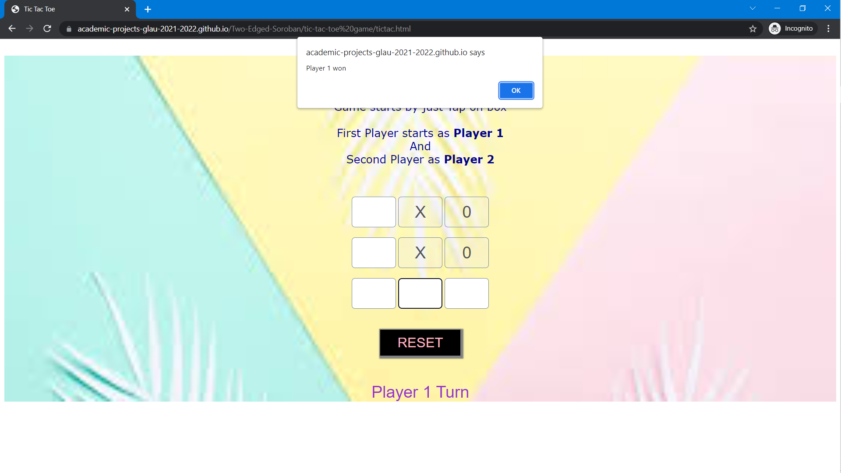
10. Tic – Tac - Toe

Slide 19
Thank You

